Slide 1
Cryptanalysis of LEDAcrypt
Daniel Apon¹, Ray Perlner¹, Angela Robinson¹, Paolo Santini²
1: NIST
2: Università Politecnica delle Marche, Florida Atlantic University

Slide 2
Our Result
We present an attack on the QC-LDPC-McEliece construction of
[Baldi et al. 2007]
This construction was the basis of the second-round NIST PQC candidate, LEDAcrypt
Prior to our attack this construction had a nearly 12-year history without a major break
Our attack was a major factor in the non-selection of LEDAcrypt for the third round of the NIST PQC process
  In response, the LEDAcrypt team published an updated spec which avoided the attack
  NIST ultimately decided that this updated spec represented too large a tweak and made LEDAcrypt too similar to its competitor BIKE
  (BIKE is based on the QC-MDPC-McEliece scheme of [Misoczki et al. 2012])

Slide 3
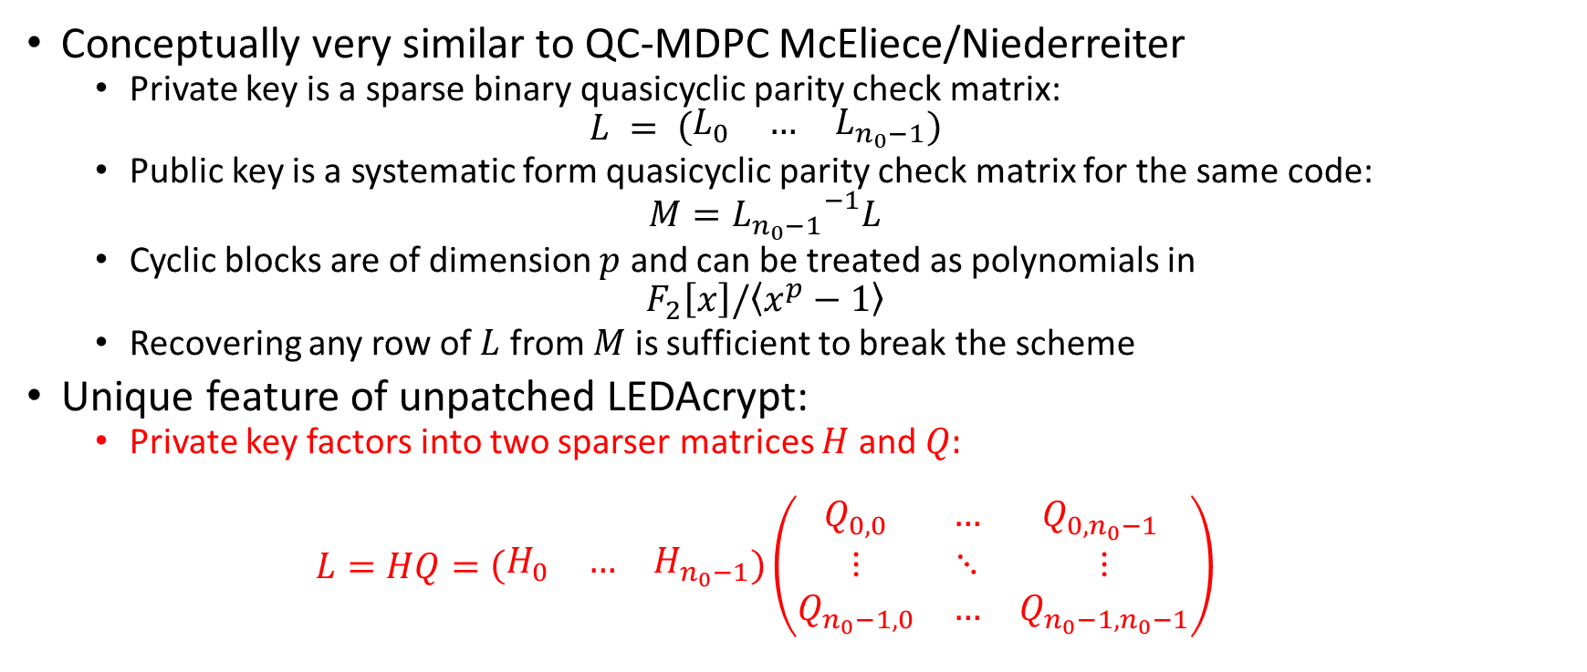
LEDAcrypt Overview
Conceptually very similar to QC-MDPC McEliece/Niederreiter
  Private key is a sparse binary quasicyclic parity check matrix:
  $$L = \left(\begin{matrix}L_{0} & … & L_{n_{0}−1}\end{matrix}\right)$$
  Public key is a systematic form quasicyclic parity check matrix for the same code:
  $$M={L_{n_{0}−1}}^{−1}L$$
  Cyclic blocks are of dimension $p$ and can be treated as polynomials in
  $$F_{2}\left[x\right]/\left\langle x^{p}−1\right\rangle$$
  Recovering any row of $L$ from $M$ is sufficient to break the scheme
Unique feature of unpatched LEDAcrypt:
  Private key factors into two sparser matrices $H$ and $Q:$
  $$L=HQ=\left(\begin{matrix}H_{0} & … & H_{n_{0}−1}\end{matrix}\right)\left(\begin{matrix}Q_{0,0} & … & Q_{0,n_{0}−1} \\ ⋮ & ⋱ & ⋮ \\ Q_{n_{0}−1,0} & … & Q_{n_{0}−1,n_{0}−1}\end{matrix}\right)$$

Slide 4
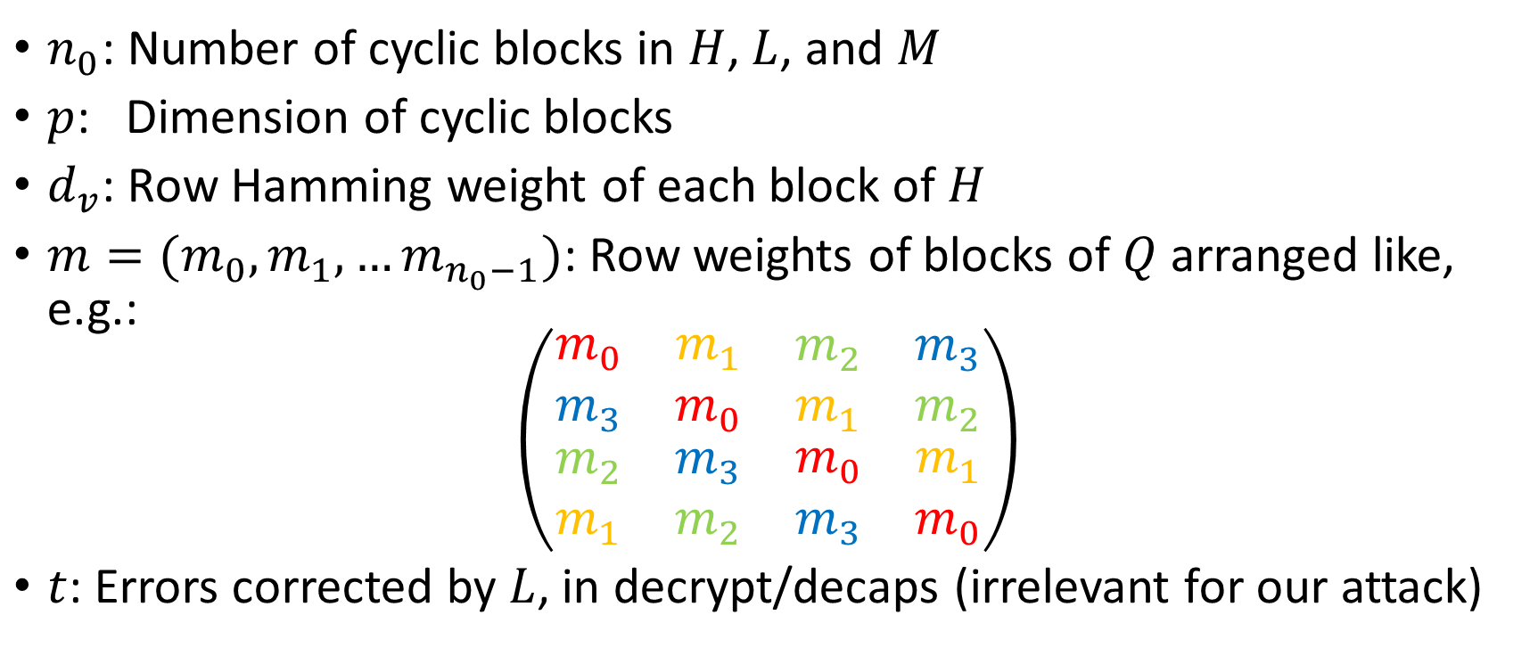
LEDAcrypt Parameters
$n_{0}$: Number of cyclic blocks in $H$, $L$, and $M$
$p$: Dimension of cyclic blocks
$d_{v}$: Row Hamming weight of each block of $H$
$m=(m_{0},m_{1},…m_{n_{0}−1})$: Row weights of blocks of $Q$ arranged like, e.g.:
$$\left(\begin{matrix}\begin{matrix}m_{0} & m_{1} \\ m_{3} & m_{0}\end{matrix} & \begin{matrix}m_{2} & m_{3} \\ m_{1} & m_{2}\end{matrix} \\ \begin{matrix}m_{2} & m_{3} \\ m_{1} & m_{2}\end{matrix} & \begin{matrix}m_{0} & m_{1} \\ m_{3} & m_{0}\end{matrix}\end{matrix}\right)$$
$t$: Errors corrected by $L$, in decrypt/decaps (irrelevant for our attack)

Slide 5
LEDAcrypt Parameters
(2nd Round, CPA)

Slide 6
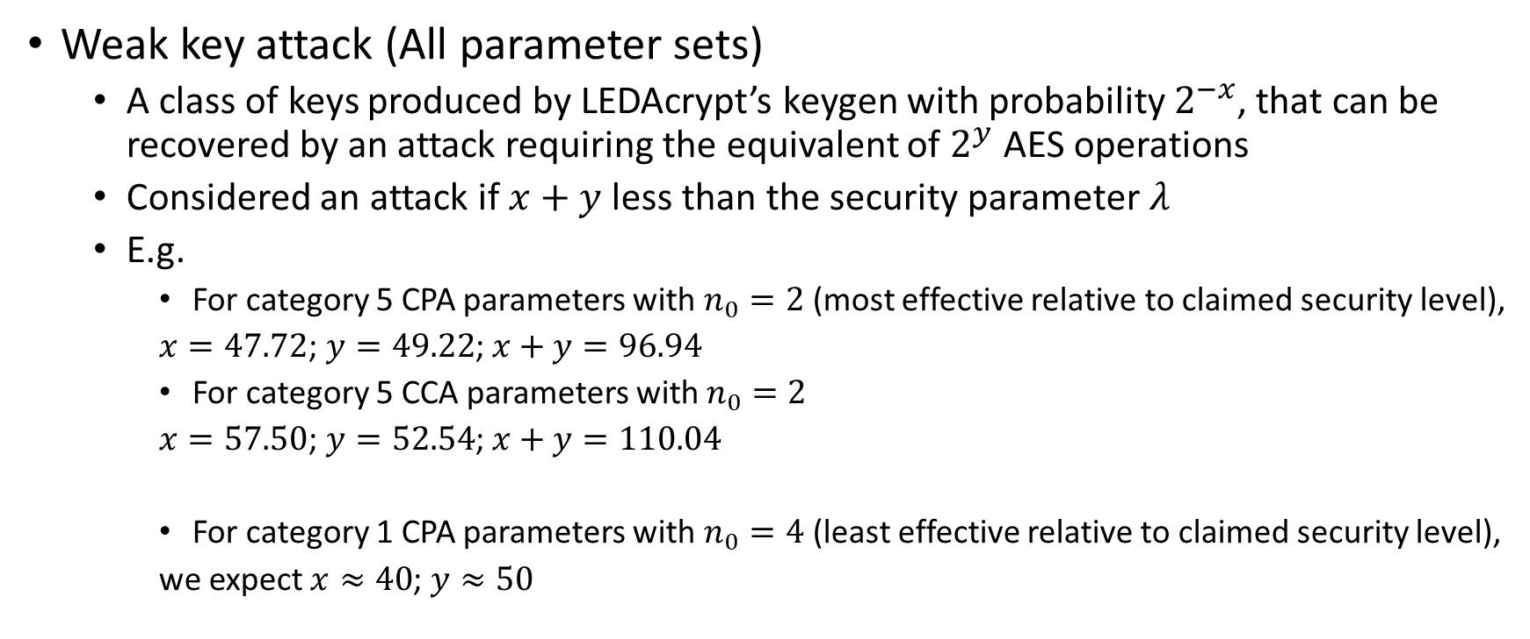
Summary of Attacks
Weak key attack (All parameter sets)
  A class of keys produced by LEDAcrypt’s keygen with probability $2^{−x}$, that can be recovered by an attack requiring the equivalent of $2^{y}$ AES operations
  Considered an attack if $x+y$ less than the security parameter $λ$
  E.g.
    For category 5 CPA parameters with $n_{0}=2$ (most effective relative to claimed security level),
    $x=47.72$; $y=49.22$; $x+y=96.94$
    For category 5 CCA parameters with $n_{0}=2$
    $x=57.50$; $y=52.54$; $x+y=110.04$
    For category 1 CPA parameters with $n_{0}=4$ (least effective relative to claimed security level),
    we expect $x≈40$; $y≈50$

Slide 7
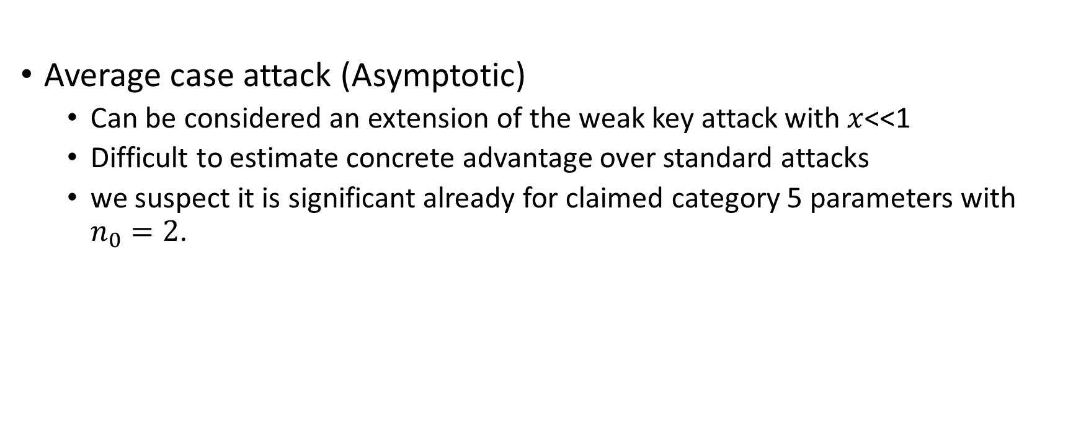
Summary of Attacks Cont.
Average case attack (Asymptotic)
  Can be considered an extension of the weak key attack with $x$<<1
  Difficult to estimate concrete advantage over standard attacks
  we suspect it is significant already for claimed category 5 parameters with $n_{0}=2$.

Slide 8
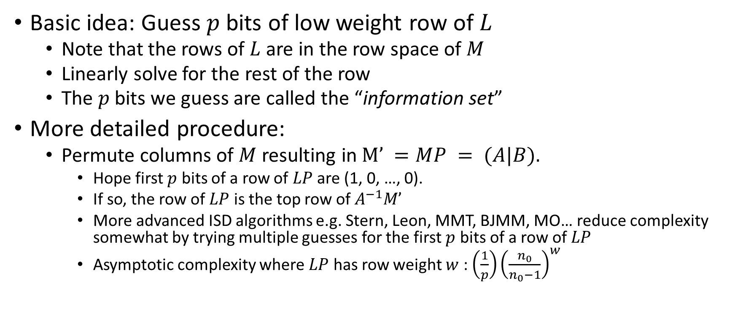
Key Recovery for MDPC Codes
Information Set Decoding
Basic idea: Guess $p$ bits of low weight row of $L$
  Note that the rows of $L$ are in the row space of $M$
  Linearly solve for the rest of the row
  The $p$ bits we guess are called the “information set”
More detailed procedure:
  Permute columns of $M$ resulting in $M’ =MP = (A|B).$
    Hope first $p$ bits of a row of $LP$ are (1, 0, …, 0).
    If so, the row of $LP$ is the top row of $A^{−1}M’$
    More advanced ISD algorithms e.g. Stern, Leon, MMT, BJMM, MO… reduce complexity somewhat by trying multiple guesses for the first $p$ bits of a row of $LP$
    Asymptotic complexity where $LP$ has row weight $w$ : ${\left(\frac{1}{p}\right)\left(\frac{n_{0}}{n_{0}−1}\right)}^{w}$

Slide 9
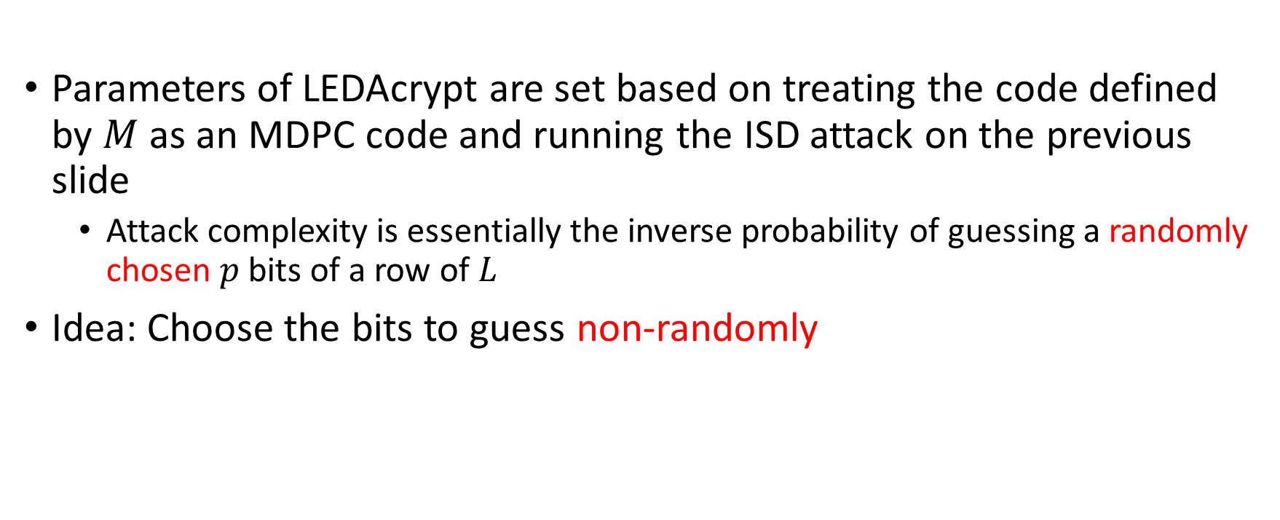
Using LEDAcrypt’s Product Structure
Basic Idea
Parameters of LEDAcrypt are set based on treating the code defined by $M$ as an MDPC code and running the ISD attack on the previous slide
  Attack complexity is essentially the inverse probability of guessing a randomly chosen $p$ bits of a row of $L$
Idea: Choose the bits to guess non-randomly

Slide 10
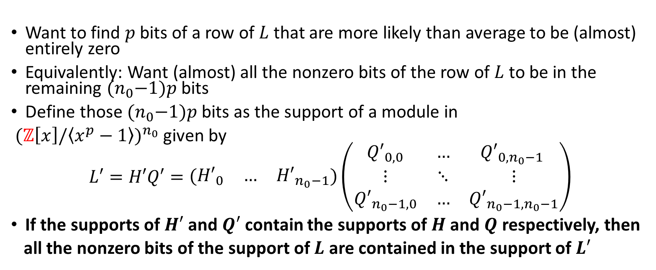
Using LEDAcrypt’s Product Structure
Choosing the Bits to Guess
Want to find $p$ bits of a row of $L$ that are more likely than average to be (almost) entirely zero
Equivalently: Want (almost) all the nonzero bits of the row of $L$ to be in the remaining ${(n}_{0}−1)p$ bits
Define those ${(n}_{0}−1)p$ bits as the support of a module in
${(ℤ\left[x\right]/\left\langle x^{p}−1\right\rangle )}^{n_{0}}$ given by
$$L′=H′Q′=\left(\begin{matrix}{H′}_{0} & … & {H′}_{n_{0}−1}\end{matrix}\right)\left(\begin{matrix}{Q′}_{0,0} & … & {Q′}_{0,n_{0}−1} \\ ⋮ & ⋱ & ⋮ \\ {Q′}_{n_{0}−1,0} & … & {Q′}_{n_{0}−1,n_{0}−1}\end{matrix}\right)$$
If the supports of $H′$ and $Q′$ contain the supports of $H$ and $Q$ respectively, then
all the nonzero bits of the support of $L$ are contained in the support of $L′$

Slide 11
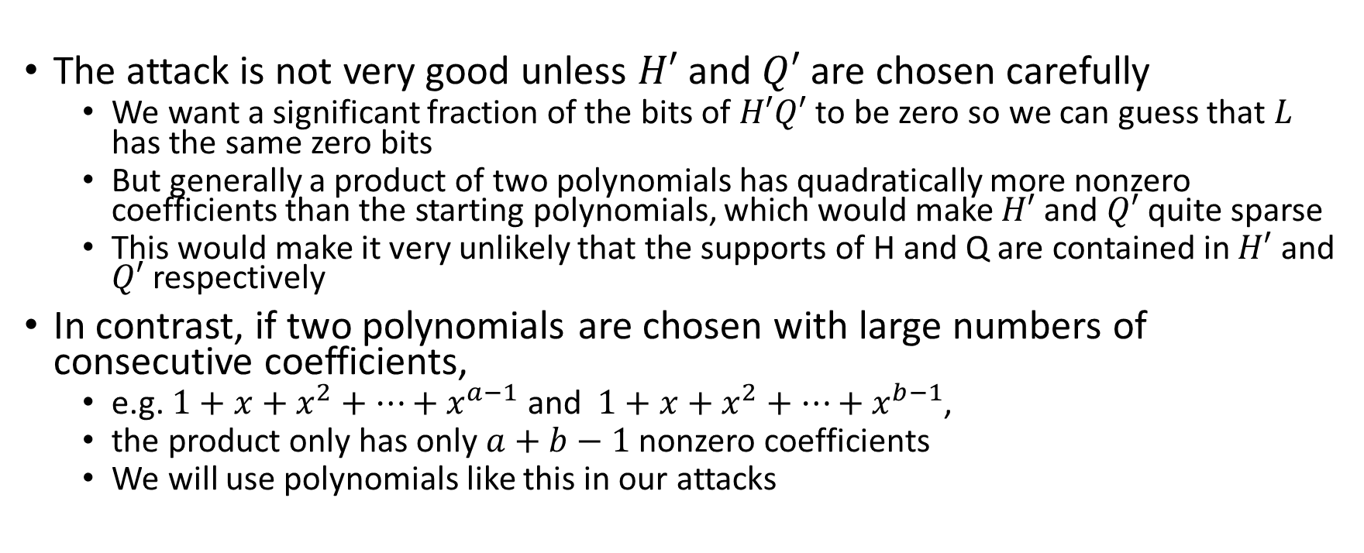
Contiguous Nonzero Coefficients
The attack is not very good unless $H′$ and $Q′$ are chosen carefully
  We want a significant fraction of the bits of $H′Q′$ to be zero so we can guess that $L$ has the same zero bits
  But generally a product of two polynomials has quadratically more nonzero coefficients than the starting polynomials, which would make $H′$ and $Q′$ quite sparse
  This would make it very unlikely that the supports of H and Q are contained in $H′$ and $Q′$ respectively
In contrast, if two polynomials are chosen with large numbers of consecutive coefficients,
  e.g. $1+x+x^{2}+…+x^{a−1}$ and $1+x+x^{2}+…+x^{b−1}$,
  the product only has only $a+b−1$ nonzero coefficients
  We will use polynomials like this in our attacks

Slide 12
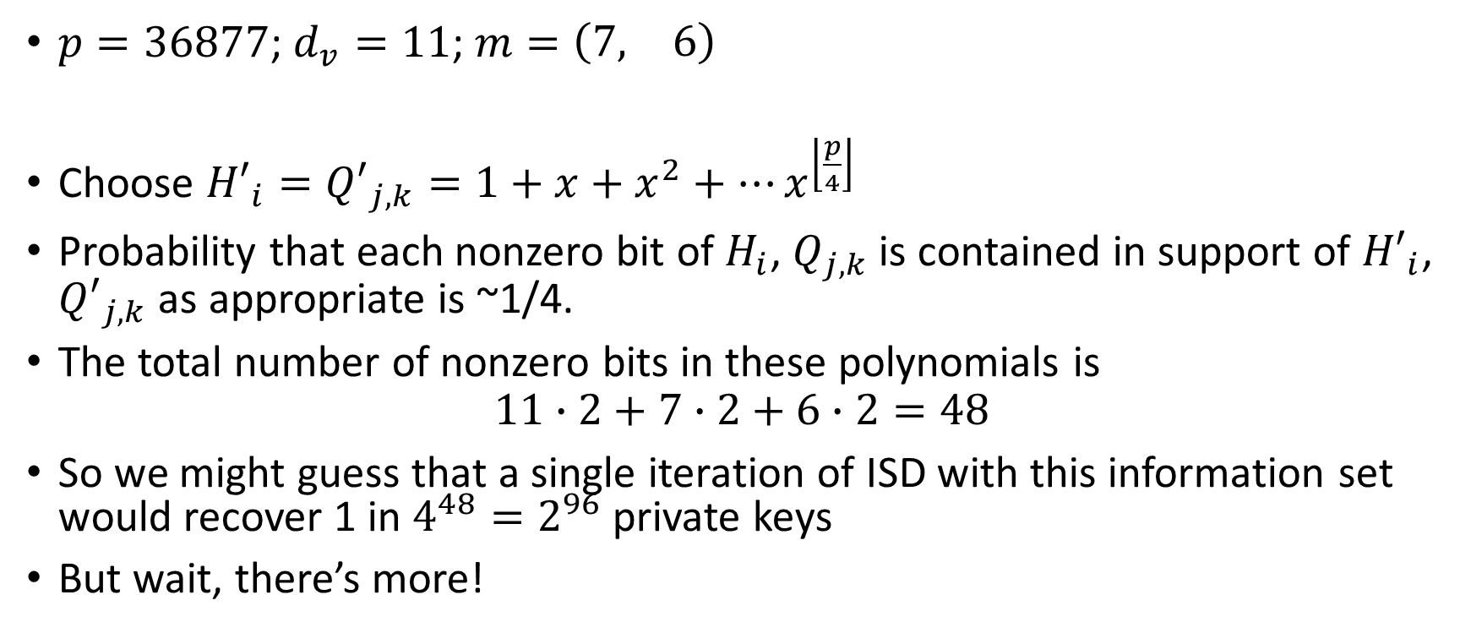
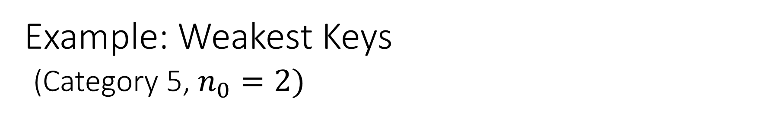
Example: Weakest Keys
(Category 5, $n_{0}=2)$
$p=36877$; $d_{v}=11$; $m=\left(\begin{matrix}7, & 6\end{matrix}\right)$
Choose ${H′}_{i}={Q′}_{j,k}=1+x+x^{2}+…x^{\left\lfloor \frac{p}{4}\right\rfloor }$
Probability that each nonzero bit of $H_{i}$, $Q_{j,k}$ is contained in support of ${H′}_{i}$, ${Q′}_{j,k}$ as appropriate is ~1/4.
The total number of nonzero bits in these polynomials is
$$11∙2+7∙2+6∙2=48$$
So we might guess that a single iteration of ISD with this information set would recover 1 in $4^{48}=2^{96}$ private keys
But wait, there’s more!

Slide 13
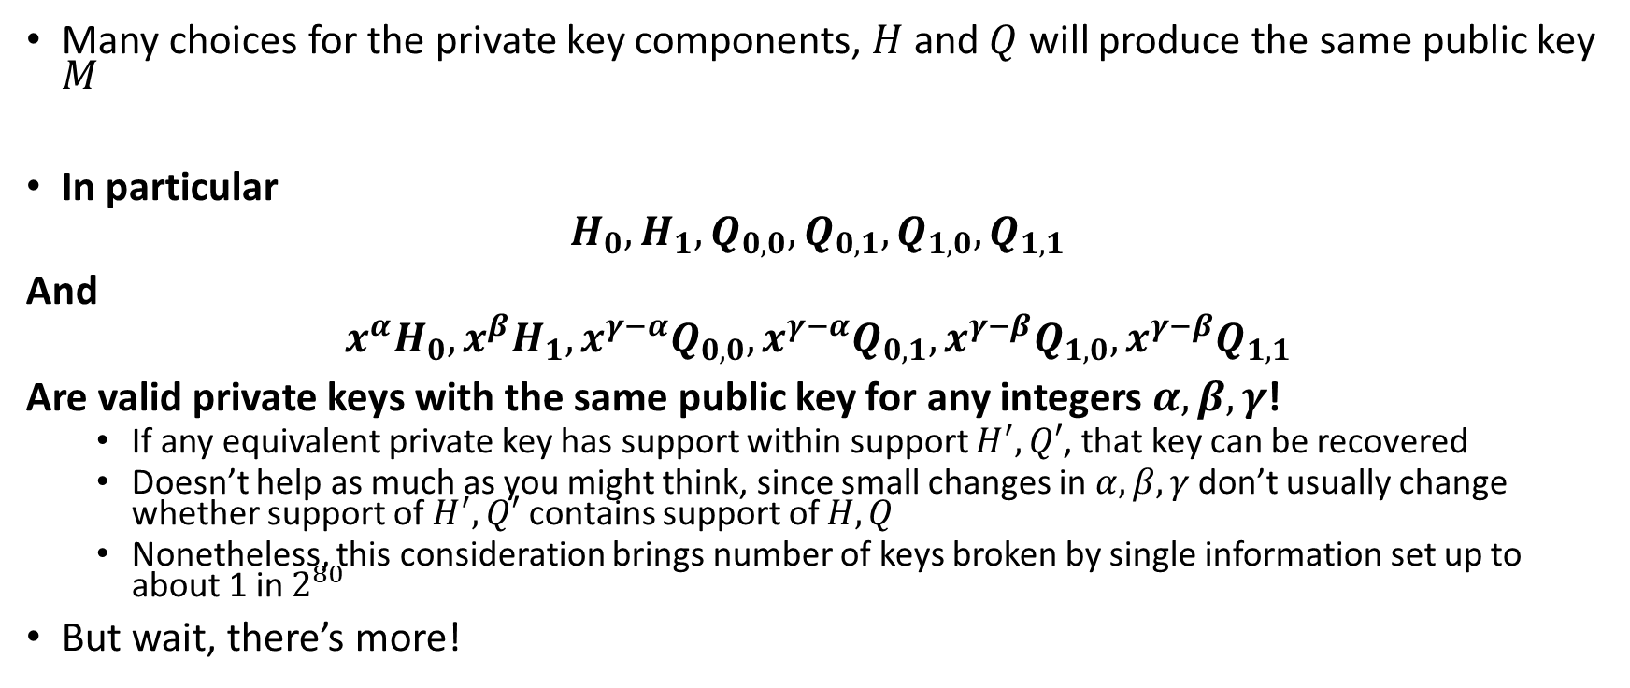
Equivalent Keys
Many choices for the private key components, $H$ and $Q$ will produce the same public key $M$
In particular
$$H_{0},H_{1},Q_{0,0},Q_{0,1},Q_{1,0},Q_{1,1}$$
And
$${x^{α}H}_{0},{x^{β}H}_{1},x^{γ−α}Q_{0,0},{x^{γ−α}Q}_{0,1},{x^{γ−β}Q}_{1,0},{x^{γ−β}Q}_{1,1}$$
Are valid private keys with the same public key for any integers $α,β,γ$!
  If any equivalent private key has support within support $H^{′},Q′$, that key can be recovered
  Doesn’t help as much as you might think, since small changes in $α,β,γ$ don’t usually change whether support of $H^{′},Q′$ contains support of $H,Q$
  Nonetheless, this consideration brings number of keys broken by single information set up to about 1 in $2^{80}$
But wait, there’s more!

Slide 14
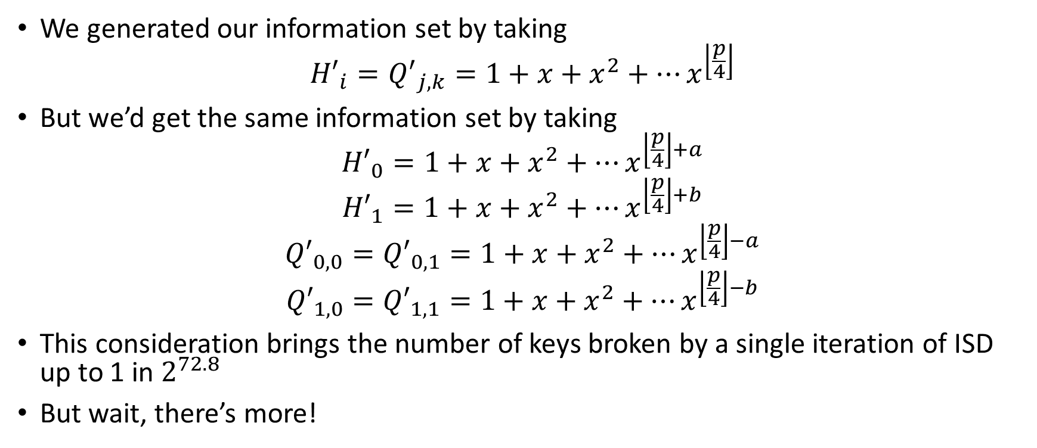
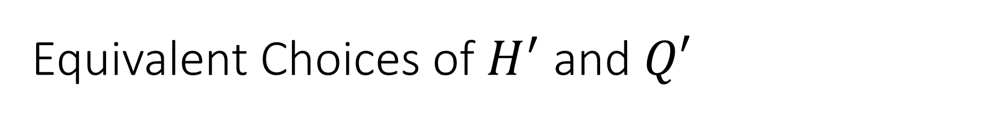
Equivalent Choices of $H^{′}$ and $Q′$
We generated our information set by taking
$${H′}_{i}={Q′}_{j,k}=1+x+x^{2}+…x^{\left\lfloor \frac{p}{4}\right\rfloor }$$
But we’d get the same information set by taking
$${H′}_{0}=1+x+x^{2}+…x^{\left\lfloor \frac{p}{4}\right\rfloor +a}$$
$${H′}_{1}=1+x+x^{2}+…x^{\left\lfloor \frac{p}{4}\right\rfloor +b}$$
$${Q′}_{0,0}={Q′}_{0,1}=1+x+x^{2}+…x^{\left\lfloor \frac{p}{4}\right\rfloor −a}$$
$${Q′}_{1,0}={Q′}_{1,1}=1+x+x^{2}+…x^{\left\lfloor \frac{p}{4}\right\rfloor −b}$$
This consideration brings the number of keys broken by a single iteration of ISD up to 1 in $2^{72.8}$
But wait, there’s more!

Slide 15
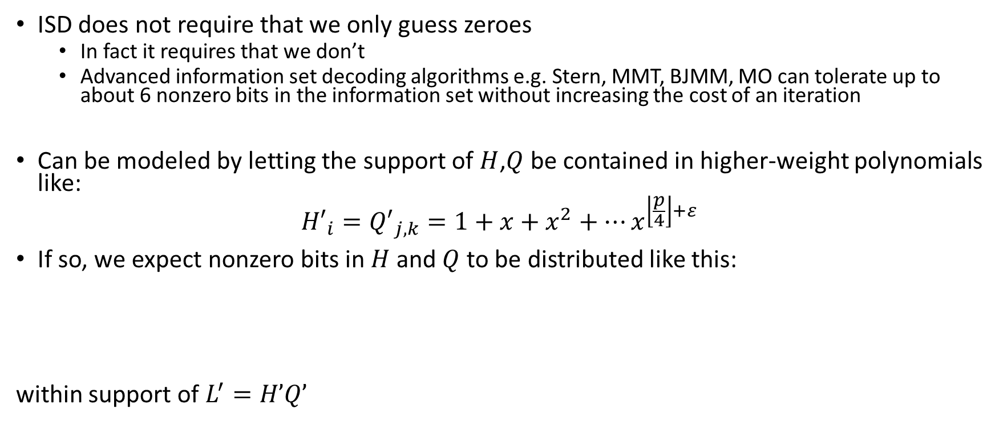
Advanced Information Set Decoding
ISD does not require that we only guess zeroes
  In fact it requires that we don’t
  Advanced information set decoding algorithms e.g. Stern, MMT, BJMM, MO can tolerate up to about 6 nonzero bits in the information set without increasing the cost of an iteration
Can be modeled by letting the support of $H$,$Q$ be contained in higher-weight polynomials like:
$${H′}_{i}={Q′}_{j,k}=1+x+x^{2}+…x^{\left\lfloor \frac{p}{4}\right\rfloor +ε}$$
If so, we expect nonzero bits in $H$ and $Q$ to be distributed like this:
within support of $L^{′}=H’Q’$

Slide 16
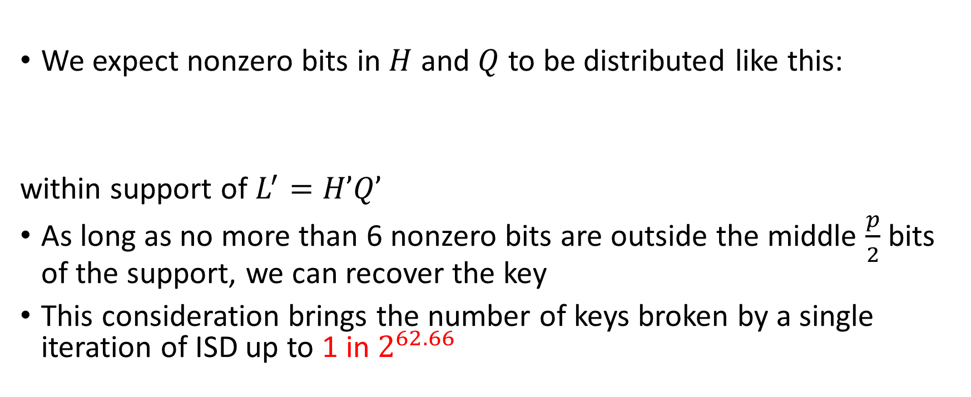
Advanced Information Set Decoding
Cont.
We expect nonzero bits in $H$ and $Q$ to be distributed like this:
within support of $L^{′}=H’Q’$
As long as no more than 6 nonzero bits are outside the middle $\frac{p}{2}$ bits of the support, we can recover the key
This consideration brings the number of keys broken by a single iteration of ISD up to 1 in $2^{62.66}$

Slide 17

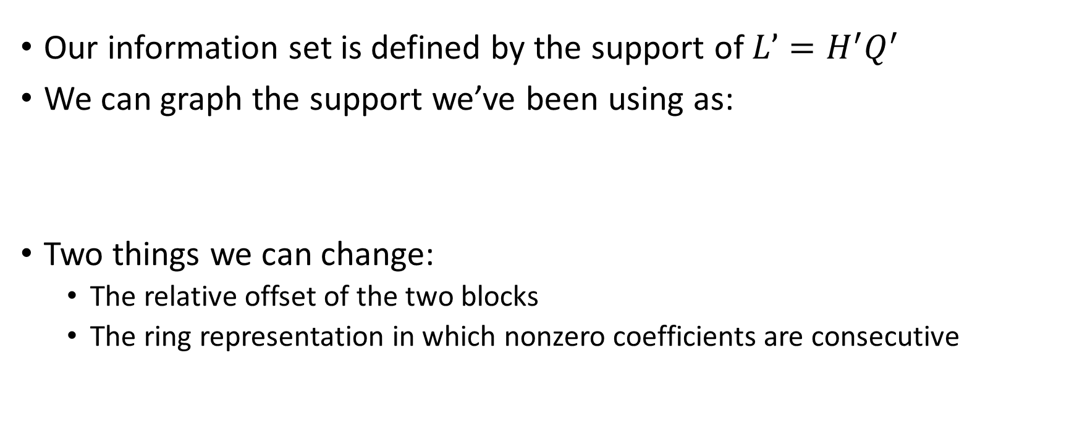

How Many Equally Good
(and Independent)
Information Sets?
Our information set is defined by the support of $L’=H^{′}Q^{′}$
We can graph the support we’ve been using as:
Two things we can change:
  The relative offset of the two blocks
  The ring representation in which nonzero coefficients are consecutive
$${L′}_{0}$$
$${L′}_{1}$$

Slide 18

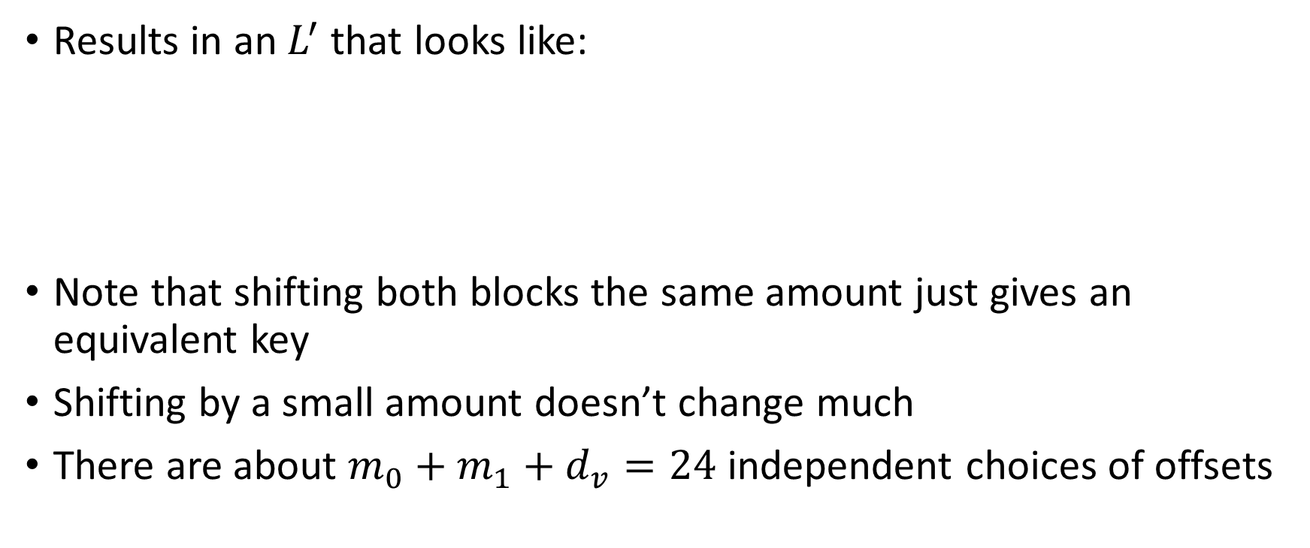

Changing the Offset
Results in an $L^{′}$that looks like:
Note that shifting both blocks the same amount just gives an equivalent key
Shifting by a small amount doesn’t change much
There are about $m_{0}+m_{1}+d_{v}=24$ independent choices of offsets
$${L′}_{0}$$
$${L′}_{1}$$

Slide 19
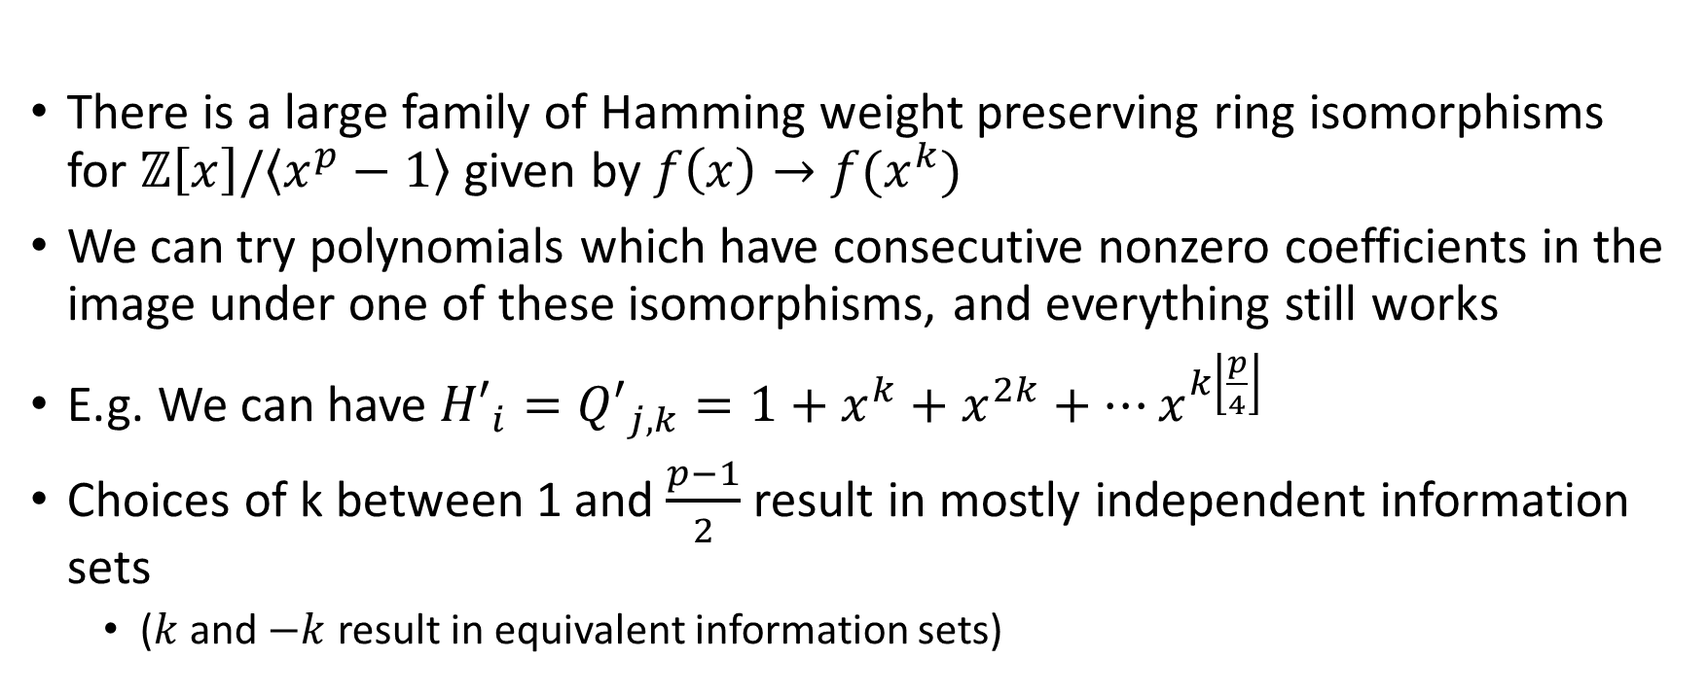
Ring Representations
There is a large family of Hamming weight preserving ring isomorphisms for $ℤ\left[x\right]/\left\langle x^{p}−1\right\rangle$ given by $f\left(x\right)→f(x^{k})$
We can try polynomials which have consecutive nonzero coefficients in the image under one of these isomorphisms, and everything still works
E.g. We can have ${H′}_{i}={Q′}_{j,k}=1+x^{k}+x^{2k}+…x^{k\left\lfloor \frac{p}{4}\right\rfloor }$
Choices of k between 1 and $\frac{p−1}{2}$ result in mostly independent information sets
  ($k$ and $−k$ result in equivalent information sets)

Slide 20
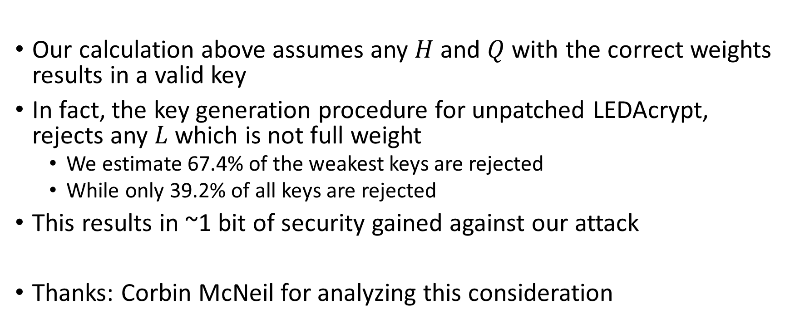
Rejection Sampling Considerations
Our calculation above assumes any $H$ and $Q$ with the correct weights results in a valid key
In fact, the key generation procedure for unpatched LEDAcrypt, rejects any $L$ which is not full weight
  We estimate 67.4% of the weakest keys are rejected
  While only 39.2% of all keys are rejected
This results in ~1 bit of security gained against our attack
Thanks: Corbin McNeil for analyzing this consideration

Slide 21
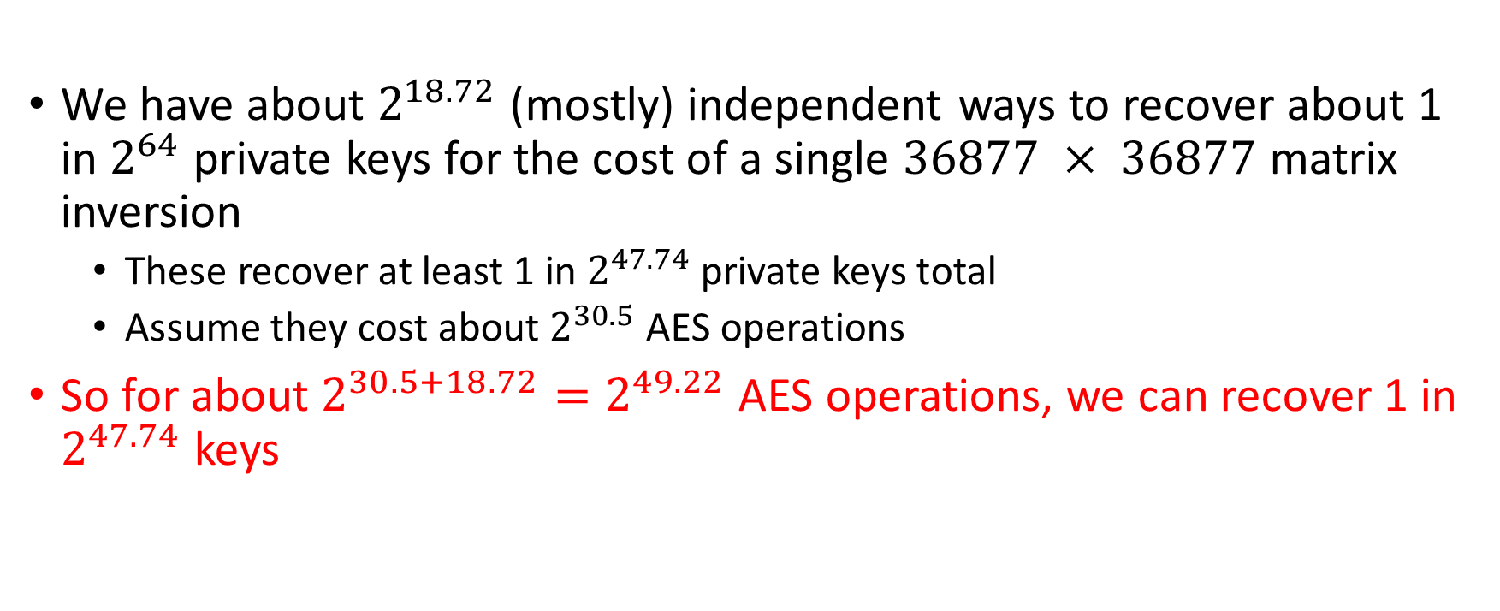
Putting it All Together
We have about $2^{18.72}$ (mostly) independent ways to recover about 1 in $2^{64}$ private keys for the cost of a single $36877 × 36877$matrix inversion
  These recover at least 1 in $2^{47.74}$ private keys total
  Assume they cost about $2^{30.5}$ AES operations
So for about $2^{30.5+18.72}=2^{49.22}$ AES operations, we can recover 1 in $2^{47.74}$ keys

Slide 22
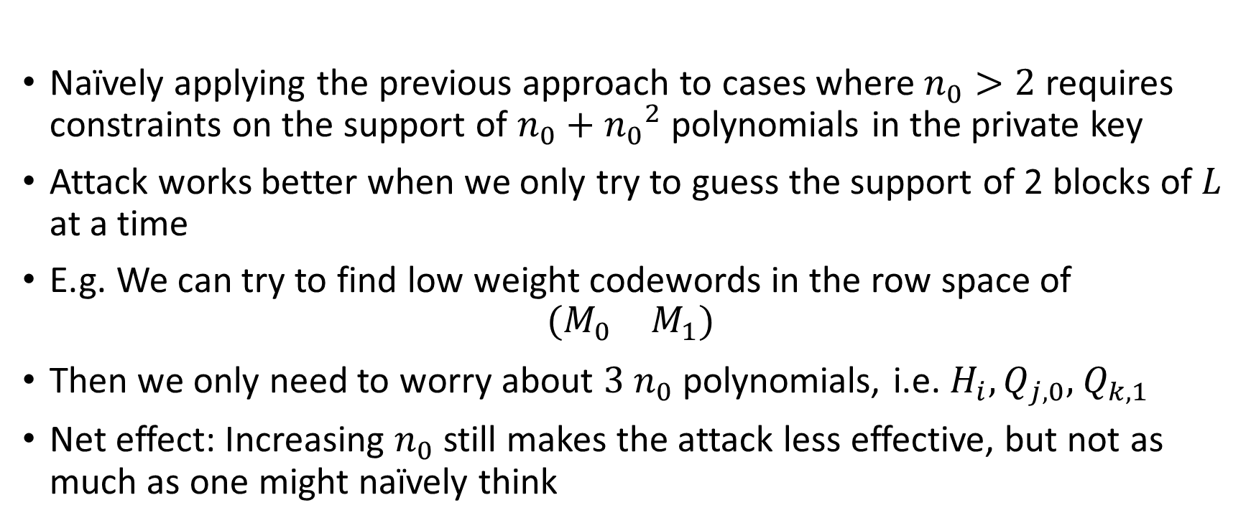

Considerations for $n_{0}>2$
Naïvely applying the previous approach to cases where $n_{0}>2$ requires constraints on the support of $n_{0}+{n_{0}}^{2}$ polynomials in the private key
Attack works better when we only try to guess the support of 2 blocks of $L$ at a time
E.g. We can try to find low weight codewords in the row space of
$$\left(\begin{matrix}M_{0} & M_{1}\end{matrix}\right)$$
Then we only need to worry about $3$ $n_{0}$ polynomials, i.e. $H_{i},Q_{j,0},$ $Q_{k,1}$
Net effect: Increasing $n_{0}$ still makes the attack less effective, but not as much as one might naïvely think

Slide 23
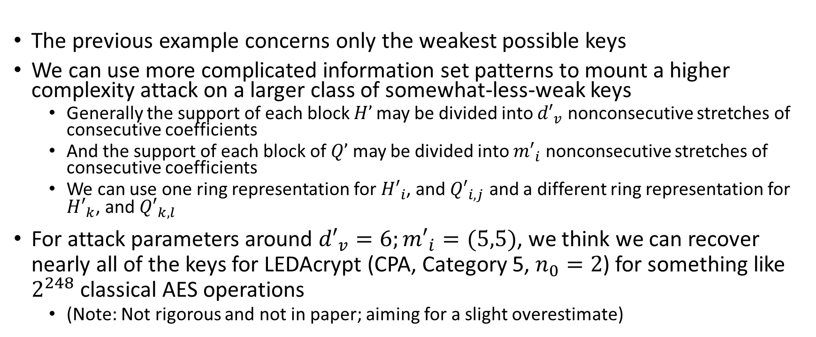
Less Weak Keys
The previous example concerns only the weakest possible keys
We can use more complicated information set patterns to mount a higher complexity attack on a larger class of somewhat-less-weak keys
  Generally the support of each block $H’$may be divided into ${d′}_{v}$ nonconsecutive stretches of consecutive coefficients
  And the support of each block of $Q’$ may be divided into ${m′}_{i}$ nonconsecutive stretches of consecutive coefficients
  We can use one ring representation for ${H′}_{i}$, and ${Q′}_{i,j}$ and a different ring representation for ${H′}_{k}$, and ${Q′}_{k,l}$
For attack parameters around ${d′}_{v}=6;{m′}_{i}=(5,5)$, we think we can recover nearly all of the keys for LEDAcrypt (CPA, Category 5, $n_{0}=2$) for something like $2^{248}$ classical AES operations
  (Note: Not rigorous and not in paper; aiming for a slight overestimate)

Slide 24
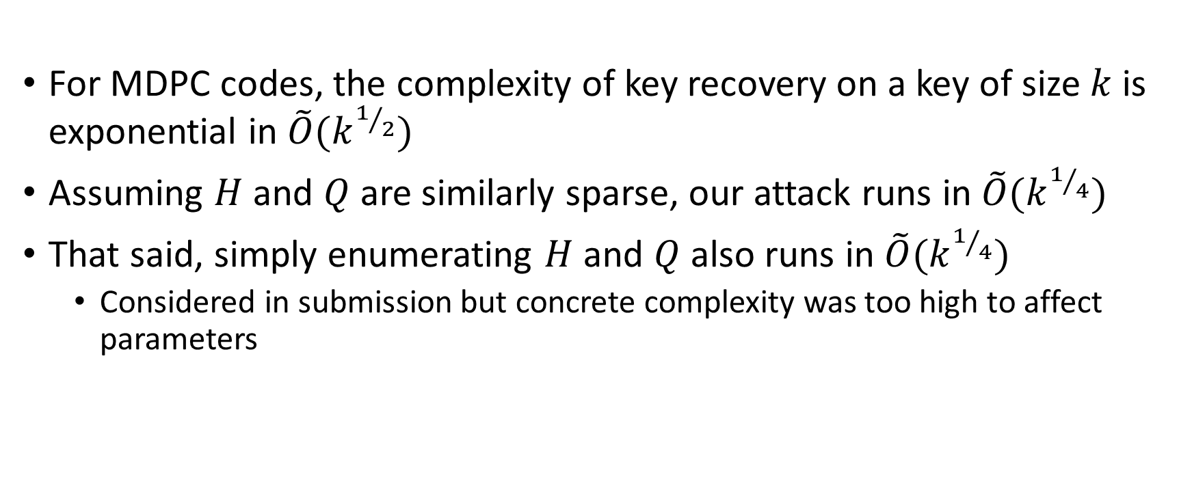
Asymptotics
For MDPC codes, the complexity of key recovery on a key of size $k$ is exponential in $\tilde{O}(k^{1/2})$
Assuming $H$ and $Q$ are similarly sparse, our attack runs in $\tilde{O}(k^{1/4})$
That said, simply enumerating $H$ and $Q$ also runs in $\tilde{O}(k^{1/4})$
  Considered in submission but concrete complexity was too high to affect parameters

Slide 25
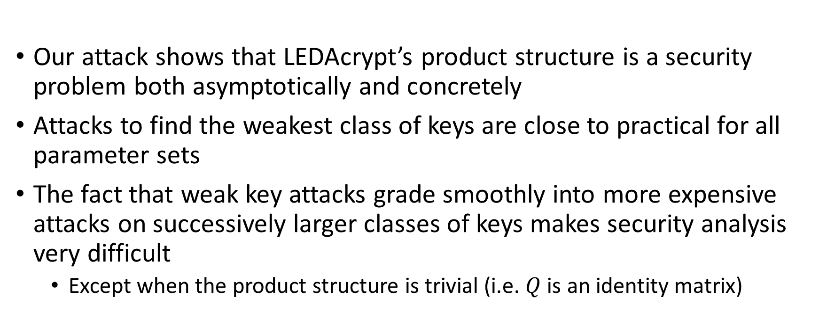
Conclusion
Our attack shows that LEDAcrypt’s product structure is a security problem both asymptotically and concretely
Attacks to find the weakest class of keys are close to practical for all parameter sets
The fact that weak key attacks grade smoothly into more expensive attacks on successively larger classes of keys makes security analysis very difficult
  Except when the product structure is trivial (i.e. $Q$ is an identity matrix)

